Slide 1



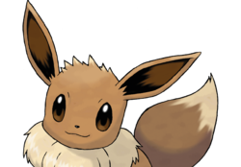

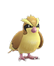



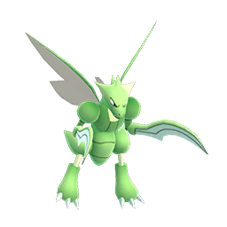
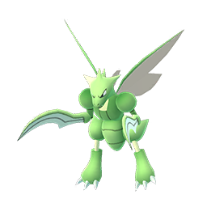
Pokemon GO
Let’s GO Meltan Field Research Tasks
Let’s Go: Make an excellent throw
Encounter ( Pidgey Too Ditto )
Stage 3
Let’s Go: Hatch 2 Eggs Encounter
( Aerodactyl – Shiny Change )
Stage 8
Let’s Go: Evolve 2 Anorith
Encounter ( Scyther )
Stage 7
  You will need of these for the Meltan quest line! Don’t catch it immediately, save it for that quest stage

